Slide 1
WELCOME TO LEEMING SENIOR HIGH SCHOOL
PREPARING FOR YEAR 7, 2022

Slide 4
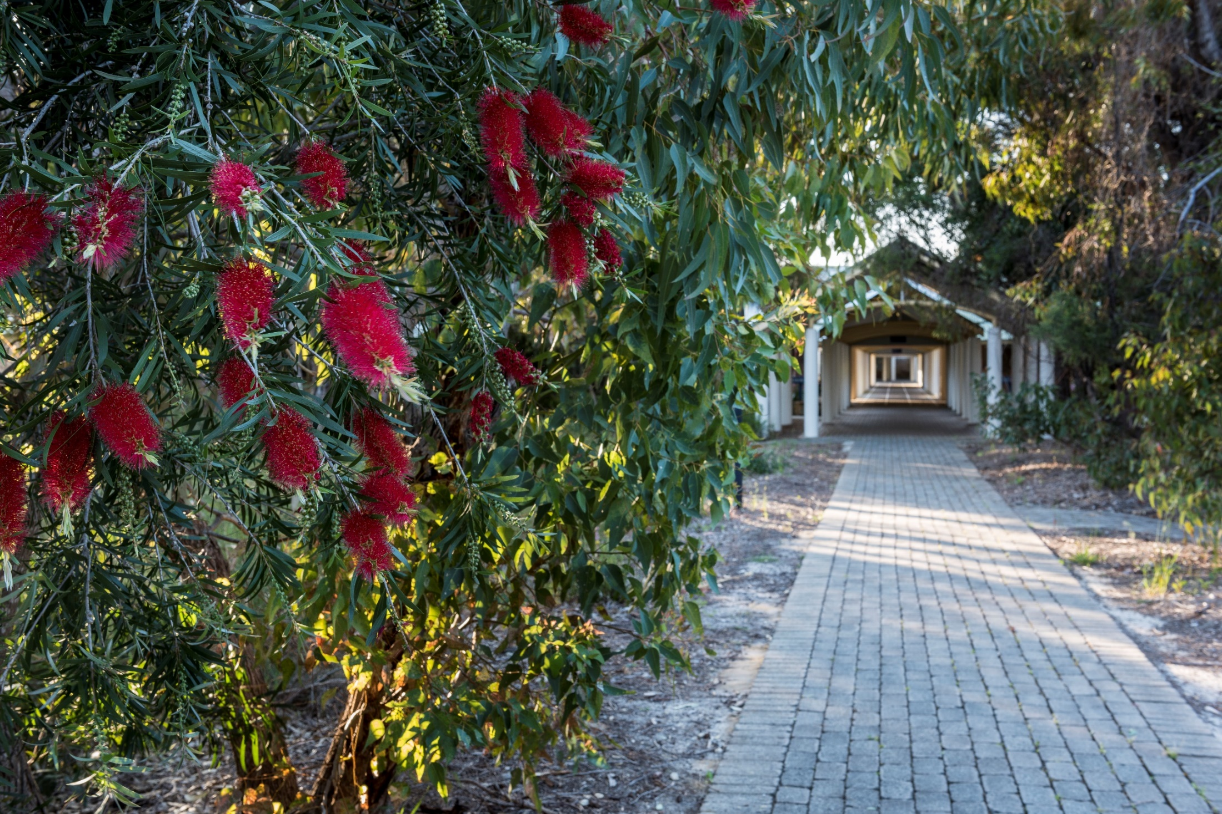
TONIGHT’S AGENDA
Principal’s address
Deputy Principal-Year 7 Curriculum
Student Services Team
Pastoral Care
BYOD
First Day Procedures
Important Dates
Welcome

Slide 5
Leeming Senior High School Principal
Mr Brendon Wallwork

Slide 6
OUR VISION & VALUES
We seek to achieve harmony and strive for excellence.
We encourage all individuals to reach their potential.
We value mutual respect, tolerance, inquiry and participation.
We value and are committed to fairness, personal responsibility and a safe, friendly and supportive learning environment.

Slide 7
LEEMING SENIOR HIGH SCHOOL
1146 students enrolled for 2022
Enrolments from 40 Primary Schools
199 Year 7s in 2021, 201 Year 7s in 2022
Improvements in 2021:
The English Department was refurbished, providing additional class space
Science Offices and two labs have been refurbished
Additional water fountains were installed (sponsored by the P&C)
New signs were installed around the school
Trees and scrub around the school were cleared to make the school more fire-safe.

Slide 9
DEPUTY PRINCIPAL YEAR 7-8 Mrs CYNTHIA GEILES
Oversees management of students in Year 7-8.
Positive Behaviour Management.
Supports engagement for students.
Communication with parents.
Learning support.
Curriculum Management
Timetabling.

Slide 10
CURRICULUM HOLA’s
MATHS
ENGLISH
HUMANITIES AND SOCIAL SCIENCES
LANGUAGES/AEP
SCIENCE
TECHNOLOGY AND ENTERPRISE
PHYSICAL EDUCATION
ARTS
Ms Sheetal Kalra
Mrs Leanne Longmire
Mrs Jessica De Beer
Mrs Mel Hansen
Dr Esther Janes
Mr Justin Cannell
Mr Shane Ellis
Mr Mark Williams

Slide 11
YEAR 7 CURRICULUM 2022
MATHS
ENGLISH
HUMANITIES AND SOCIAL SCIENCES
LANGUAGE – FRENCH OR JAPANESE
SCIENCE
HEALTH
PHYSICAL EDUCATION
Electives (students need to study 1 performance and 1 visual art subject)
TECHNOLOGY AND ENTERPRISE (incl. COMPUTING)
ARTS (MUSIC, DRAMA, ART, MEDIA, DANCE)
4hrs per week
4 hrs per week
4 hrs per week
2 hrs per week
4 hrs per week
1 hr per week
2 hrs per week
2 hrs per week
2 hrs per week

Slide 12
TIMETABLES
Arts (performing and visual) and Technology and Enterprise are now compulsory elective areas.
Digital Technologies will be studied all year in Year 7.
Language is compulsory and a year-long program in Years 7 and 8.
Students will receive their timetable in Week 1.
Students will need to make multiple copies of their timetable – in diary and their file/notebook, copy on the fridge…

Slide 13
YEAR 7 CURRICULUM 2022
SPECIAL PROGRAMS:
Resiliency Program will be incorporated in the Health and Physical Education program.
Digital Literacy & Inquiry Skills Program: 1 hour per week each term with time from Maths, Science, English and HASS.
Cyber Safety presentation with Paul Litherland

Slide 14
YEAR 7 PAT TESTING
Week 3
Need BYOD
Data used to monitor student progress over time and teacher effectiveness.

Slide 15
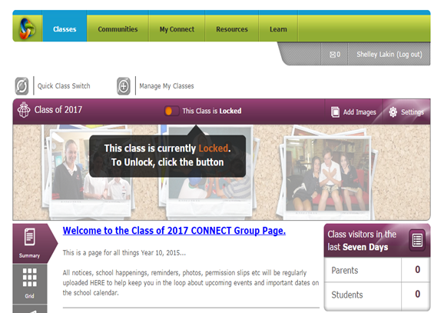
CONNECT
All students have a Connect account e.g. John.Citizen@student.education.wa.edu.au
Passwords are the same as their school password.
Students and Parents can access Connect 24/7 to access subject specific course content.
Access via de portal
https://connect.det.wa.edu.au/
It is a major conduit for communication between teachers and parents, we therefore recommend checking it regularly.

Slide 16
SCHOOL RULES, POLICIES & GUIDELINES
Based on the Rights and Responsibilities of our School Community
Behaviour
Uniform
School Grounds
Property and Security
Extra Curricula Activities
For Appropriate use of Computer Facilities
For Appropriate Mobile Phones and Other Personal Electronic Devices Usage
BYOD Device Policy and Information

Slide 17
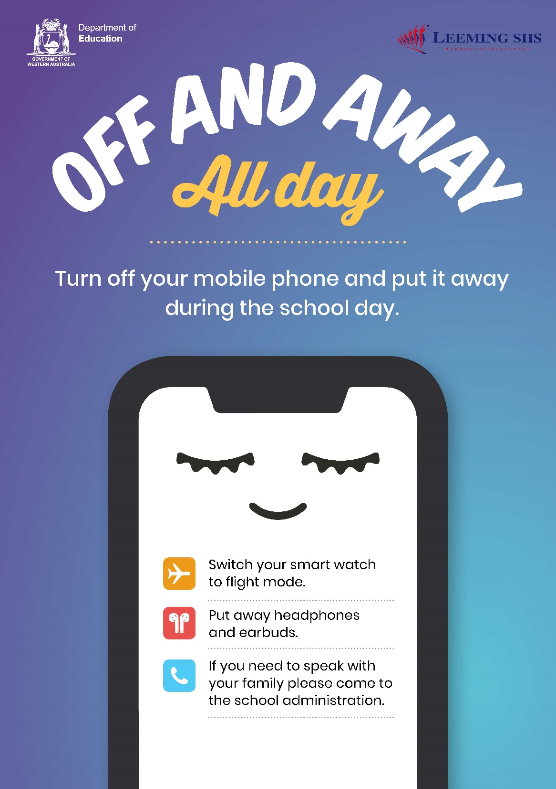

Slide 18
LEARNING TECHNOLOGIES USAGE AGREEMENT
All students & parents were required to complete and sign a Learning Technologies Acceptable Usage Agreement in the Enrolment Package
Third Party consent.

Slide 19
BYOD
Bring Your Own Device
Leeming is a BYOD school. Device specifications & Information will be placed on the school website and Connect for all parents after the Fees and Charges have been posted out.
Contact: christine.steel@education.wa.edu.au

Slide 20
BYOD 2022
All Year 7 students will participate in the Digital Literacy & Inquiry Skills program.
During Term 1 they will learn how to:
Access the Department of Education Portal
Log on to School Email, Connect and the School network
Organisation – set up subject folders
During Week 2 – bring the device to check access to the school Wi-Fi.
Week 3 - students will be doing PAT testing and need to bring their device to school.
The aim is for all Year 7 students to have access to the school’s Wi-Fi by the end of Week 2.

Slide 21
BYOD PREFERRED SUPPLIER & MINIMUM SPECIFICATIONS
Leeming SHS has negotiated a preferred supplier with JB Education. http://www.jbeducation.com.au/byod/ (Password - leemingshs2022)
BYOD can be purchased from preferred supplier or retailer of choice. (Must meet minimum requirements)
See Website.

Slide 22
PREFERRED DEVICES
Surface Pro 6 (Pro 4 or Above) 256 gb, 8gb Keyboard Digital Pen Windows 10 Pro
Surface Go 128gb Keyboard Digital Pen Windows 10 Pro
Microsoft Surface Laptop
See Website

Slide 23
STUDENTS WHO HAVE A LAPTOP/TABLET FROM PRIMARY SCHOOL
Students can bring devices to Leeming SHS providing they have the minimum specifications.
Apple Macbooks are able to be connected to the school network and there is now a free Office 365 App. (Please be aware that there is limited functionality – ie – no touch screen, some apps do not work)

Slide 24
ELECTRONIC DEVICES – 1
The use of mobile phones for students is banned from the time they arrive at school until the end of the school day – including before school and at break times.
Phones must be turned off during school hours and kept off and out of sight until the end of the school day.
The ban restricts the use of mobile phones, smart watches, earbuds, tablets and headphones.

Slide 25
ELECTRONIC DEVICES – 2
Students should never use their phone/device to take photos or videos of themselves or other students. This includes travelling to and from school. The Director General has made specific the consequence for this type of behaviour, which is suspension from school.
Leeming SHS will accept no responsibility for theft, loss, damage or health effects (potential or actual) resulting from having a mobile phone.

Slide 26
ELECTRONIC DEVICES – 3
Inappropriate use of electronic devices will result in the device being confiscated by staff.
The device will be given to the Head of Learning Area.
The student will be permitted to collect their device at the end of the day.
Students who continue to break the rules will have their privilege removed.

Slide 27
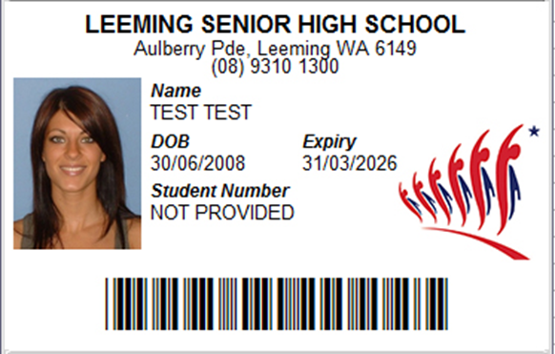
LEEMING SHS SMARTRIDER LIBRARY CARD

Slide 28
BUS INFORMATION
Morning Service Cockburn Station - Bus 515 departs at 7:51 am arrives at Leeming SHS at approximately 8:11 am.
Morning Service Murdoch Station - Bus 515 departs at 8:07 am. Bus 516 departs at 8:10 am. Buses arrive at Leeming SHS at approximately 8:16 am.(Bus 515) and 8:18 am (Bus 516)
Afternoon Service to Murdoch Station - will include 4 buses leaving Leeming SHS at 2:58 pm and 1 bus at 3:36 pm.
Afternoon Service to Cockburn Station - leaves Leeming SHS 2:58 pm.

Slide 29
THE SCHOOL DAY
We do not have bells at LSHS. Students are required to be in class at 8.30 am.
If your child is late to school they are required to sign in at Student Services and collect a late note before they go to class.
If students arrive late without reporting to Student Services a text message will be sent home to indicate your child is absent.

Slide 30
UNIFORM
Wearing the school uniform is compulsory both in school and on out-of-school excursions. The Physical Education uniform is also compulsory.
Students are expected to wear the school uniform every day and to change into their Physical Education uniform during their Physical Education lessons.

Slide 31
ATTENDANCE - COMPASS
The Parents/Guardians of a student who is absent from school are requested to:
Contact the school via the Compass App.
Write a note explaining the absence and arrange for your child to give it to the Attendance Officer located in the Student Services building.
Inform the school of planned holidays – keep in mind that holidays will be marked as “K” “unauthorised absences” as outlined in Departmental Guidelines and will impact upon your child’s attendance record.
All unexplained absences from school will have an SMS sent to parents between 10:00-11:00 am on the day of absence.

Slide 33
STUDENT SERVICES MANAGER YEAR 7-8 Ms ANGELA KOIOS
Co-ordinate Programs for Social and Emotional Wellbeing.
Work closely with and support Student Services Team.
Support Year Co-ordinator in managing attendance.
Support and management of pastoral care Years 7-8.
Parent contact.
Liaison with Primary Schools.

Slide 34
STUDENT SERVICES TEAM
Deputy Principal
Student Services Manager Year 7-8
Year 7 Coordinator
Learning Support Coordinator
Attendance Officer
Nurse
Psychologist
Chaplains

Slide 35
STUDENT SERVICES TEAM
Student Services Manager
Year 7 Coordinator
Learning Support Coordinator
School Psychologist 2022
School Chaplains
School Nurse
Attendance Officer
Ms Angela Koios
Mr Dillon Webb
Mrs Sally Burgess
Ms Vanessa Birkinshaw
Mrs Bettina Carter and Mr. Carl Hough
Mrs Deb Kitak
Ms Joanne Cobby

Slide 36
PASTORAL CARE
The Student Services team with the support of classroom teachers implement a multi-faceted pastoral care program.
The primary focus in Year 7 is developing a positive approach to High School and building relationships with peers and members of staff.
Term 1 & 2 activities aim to encourage the development of relationships. Activities include- lunch activities, sport / house activities, team building and a parent meeting.
Year assembly every Monday during House Group time.

Slide 37
PASTORAL CARE
House System has operated for many years
Students meet with their House Group teacher each day after recess – 10 minutes
Whole school and year group activities
Many opportunities for your child to be involved in activities they would like to “give it a go” and challenge themselves
Students are awarded House Points which contribute to the shields

Slide 38
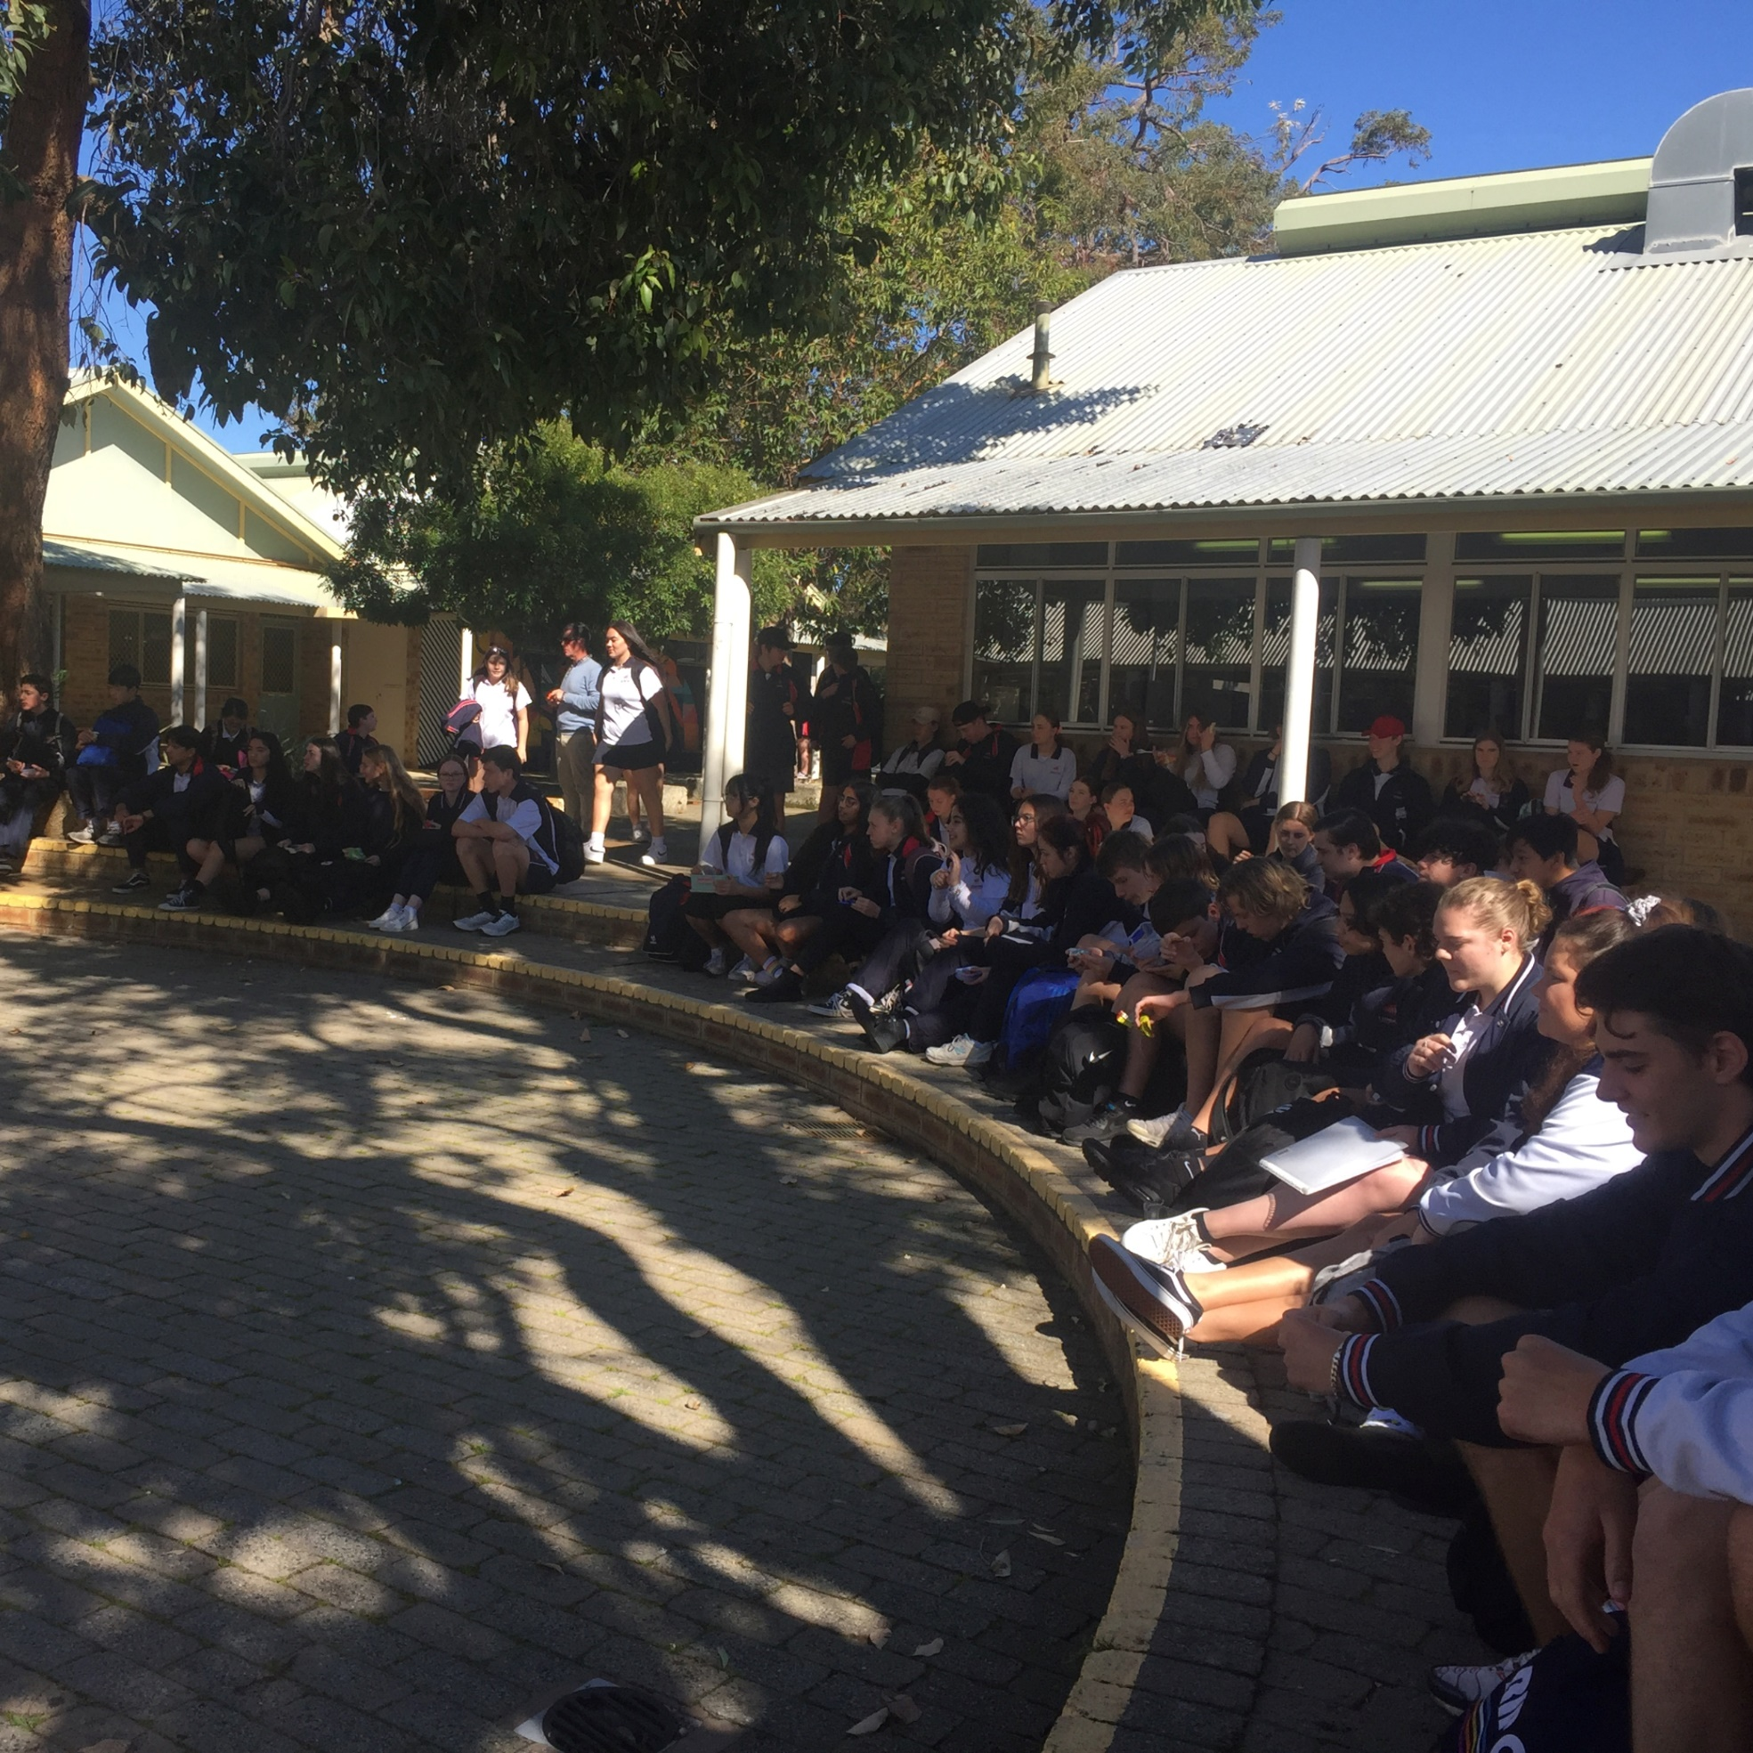
CLUBS, EVENTS AND ACTIVITIES

Slide 39
YEAR 7 CO-ORDINATOR Mr DILLON WEBB
An Important Contact for Students
Organize Year 7 Cohort Events and Activities
Year 7 Attendance Matters

Slide 40
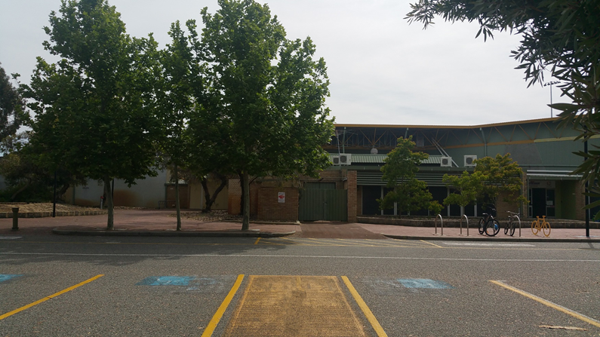
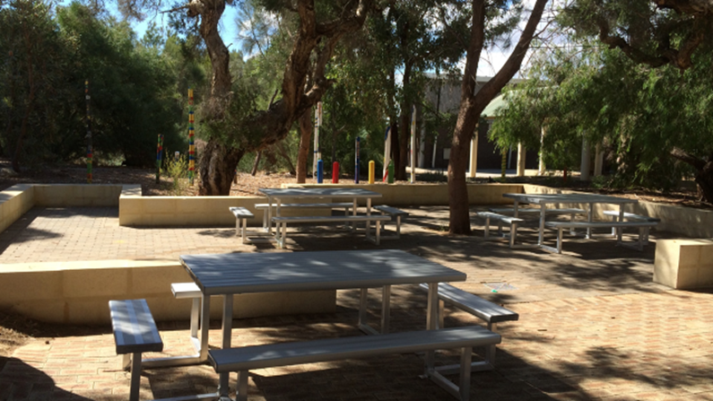
TRANSITION DAY MEETING POINTS
1. Meeting Points
a) Beginning of the Day: Performing Arts Centre at the Leeming Recreation Centre at 8.15 am
b) Recess and Lunch: Recess at 10.30am duration 30 mins and Lunch at 1.15pm duration 30 mins in the Sunken Garden
c) End of the Day: Leeming Recreation Centre at approx. 2:40 pm (preferred) or the Sunken Garden at 2:45 pm.
If your child is meeting a sibling please ask them to make a specific arrangement. Parking is not available at the front of the school.

Slide 41
TRANSITION DAY
2. What to bring: Exercise A4 Book, water bottle, pencil case (with some pens), packed recess/lunch or money for lunch only. Students must wear their Primary School uniform and sneakers.
3. What to expect:
Parents may wait with their child until we go into the PAC for our Assembly.
Students will have a “taster” of a high school day, by moving to different lessons with the assistance of Youth Leaders.
There will be opportunities to ask questions and meet key members of staff.
Students will receive a booklet to take home and help them
with Day 1, 2021.
A photograph will be taken for the SmartRider cards.

Slide 42
FIRST DAY 2022
Please note: Teachers will collect students from the Sunken Garden for the first session of that subject.
Meeting points:
Sunken Garden at 8:15 am or
Leeming Recreation Centre at 8:25 am
Ready for Whole School Assembly 8:30 am- 8:45 am
2. What to bring:
Exercise A4 Book, pencil case, packed recess/lunch, full school uniform (do not need to bring Physical Education change of clothes), sneakers, diary.
*Students will have a Year 7 Assembly and then receive their orientation program after meeting their House Group teacher.
3. After School:
Parents please pre-arrange pick up time/place (Recreation Centre is recommended for ease of access).
4. School Buses
4 Buses to Murdoch Station (3 leaving at 2.58pm and 1 at 3.32pm)
1 Bus to Cockburn Station leaves at 2.58 pm

Slide 43
WEEK ONE 2022 - ORIENTATION
Monday, Tuesday, Wednesday students will participate in structured sessions to help them with transition to Leeming Senior High School.
Values
Team Work
Getting to know each other.
Getting to know the staff and school.
Students begin their timetabled courses on Thursday.
Readiness for learning.

Slide 44
SUNKEN GARDEN

Slide 45
PREPARING YOUR CHILD FOR SECONDARY SCHOOL
WHAT PARENTS CAN DO (1)
Be prepared
Talk with your child’s primary school teacher to find out how they are helping your child prepare for the move to secondary school.
Attend our parent nights and information sessions. These are good opportunities to find out what is happening, to ask questions and meet other parents.
Visit our website to see what is happening at our school and read some of the recent newsletters.

Slide 46
PREPARING YOUR CHILD FOR SECONDARY SCHOOL
WHAT PARENTS CAN DO (2)
Encourage your child attend our transition activities like our Orientation Day.
At our Orientation Day your child will receive a handbook. Read it together so you are familiar with our policies (like the mobile phone use or uniform policy).
Let us know if your child has a medical condition, any special needs or if you are concerned about something.
Reflect how much screen time your child has daily and how this may impact their learning.

Slide 47
BEFORE YOUR CHILD STARTS SCHOOL (1)
Ask questions such as What do you think secondary school will be like? and What are you looking forward to?
Listen to your child’s concerns (e.g. getting lost) and work out a plan to deal with them if they occur.
Talk about meeting new people, making friends and getting to know the teachers.

Slide 48
BEFORE YOUR CHILD STARTS SCHOOL (2)
Make sure your child knows where to find the Year Coordinator and Student Services, in case they need help or advice.
Talk about the school routine and timetables and make sure they know the layout of the school.
Help your child to be realistic about taking time to settle in to the new environment.
Be available to listen when your child has questions or wants to talk about school.

Slide 49
ON THE FIRST DAY
MAKE SURE YOUR CHILD IS WELL PREPARED BY:
Being well rested (a good sleep is important)
Having a good breakfast
Wearing school uniform
Arriving with plenty of time
Knowing where to meet friends inside the school grounds
Knowing where to assemble for Day One
Taking healthy food for morning recess and lunch
Having all belongings clearly named
Arranging an agreed pick up time (include a backup plan in case something unexpected happens.)

Slide 50
THE FIRST WEEKS OF SCHOOL
Ask how their day at school was and what school is like.
Talk positively with your child about school and focus on their successes.
Reinforce strategies such as thinking positively, taking deep breaths, getting enough sleep at night and eating well.
Listen and provide opportunities for your child to talk.

Slide 51
IMPORTANT DATES
Transition Days: Monday 6 and Tuesday 7 December
Booklists/Contributions and Charges: E-mailed in 2 weeks and on school website located under Resources.
First Day 2022: Monday 31 January 2022
Year 7 Parent Information Evening: Thursday 17 February 2022, 6 pm–7 pm
School Photo Day: Friday 11 March 2022
(School photo Catch up day : Friday 18 March 2022)

Slide 52
QUESTION TIME
Please direct your questions to the most appropriate person.
E-mails can be found on our website: http://www.leeming.wa.edu.au/our-school/staff/
Special Educational Needs
BYOD
First Day/General Enquiries
All other enquiries
Sally Burgess
Learning Support Coordinator
Chris Steel Teacher Librarian
Dillon Webb
Year Coordinator
Angela Koios
Student Services Manager
Year 7-8

Slide 53
SCHOOL DETAILS
School Telephone: 9237 6800
Attendance Officer:
9237 6860 (landline)
0408 956 958 Compass (text message)
School Address: Aulberry Parade, Leeming 6149
Email: leeming.shs@education.wa.edu.au
Website: www.leeming.wa.edu.au
Facebook: @leeming.shs
P&C: lshspandc@gmail.com (President: Michael Blakemore)

Slide 54
YEAR 7 – IMPORTANT CONTACTS
Principal
Deputy Principal
Student Services Manager
Year Coordinator
School Telephone
School Email
School Website
School Facebook Page
School Address
Absentee Line
Brendon Wallwork
Cynthia Geiles
Angela Koios
Dillon Webb
9237 6800
General Enquiries
www.leeming.wa.edu.au
@leeming.shs
Aulberry Parade, Leeming, WA 6149
Compass App.
leeming.shs@education.wa.edu.au

Slide 55
UNIFORM SHOP OPENING HOURS
2021
Every Tuesday, Wednesday and Thursday 10:15 am – 1:45 pm
Last Days for 2021: Tuesday 8, Wednesday 9 and Thursday 10 December 10:15 am – 1:45 pm
2022
Wednesday 27,Thursday 28, Friday 29 January
8:30 am - 3:00 pm
Monday 31 January (First Day of School)
The Uniform Shop will then go back to normal opening hours
Tuesdays, Wednesdays and Thursdays 10:15 – 1:45 pm

Slide 56
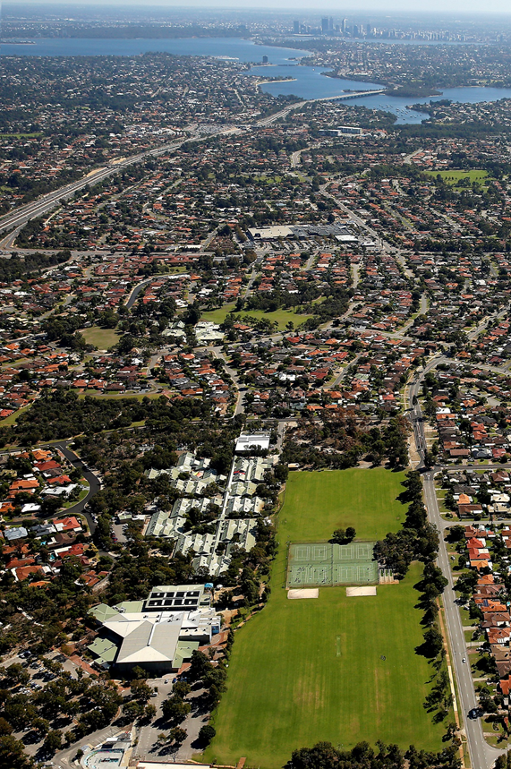
CHECK OUR WEBSITE FOR UPDATES

Slide 57
SLIDES AVAILABLE ON OUR WEBSITE
The slides from tonight’s presentation will be available on our website tomorrow.
Go to the Menu and select Year 7 2022 Information Evening.

Slide 58
Thank you for
your attendance.
We look forward to working with you in the years ahead.

Slide 59
IMMS STUDENTS 5-6PM
GORDON RYDER
Music Teacher

